Slide 1
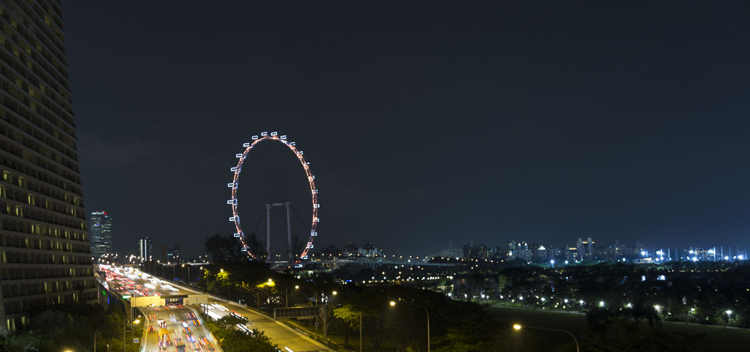










PowerShell Conference Asia

Slide 2
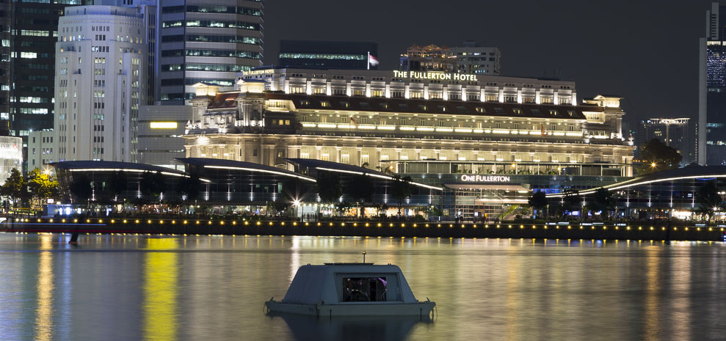
PowerShell Conference Asia

Slide 3
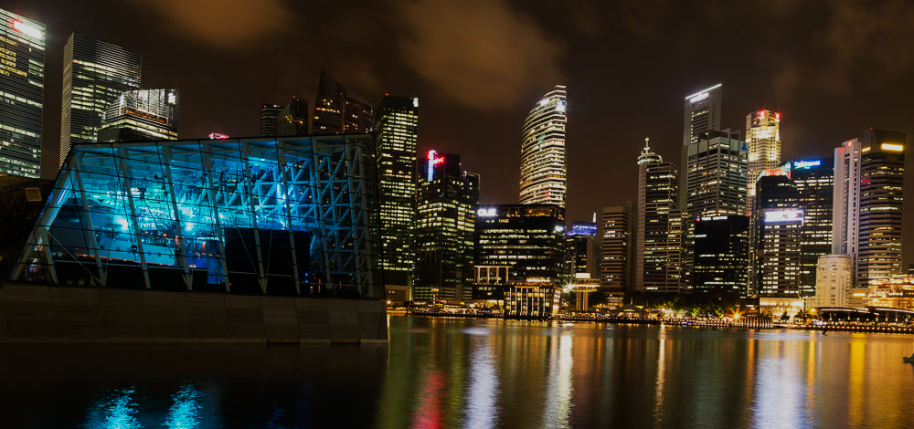
PowerShell Conference Asia

Slide 4
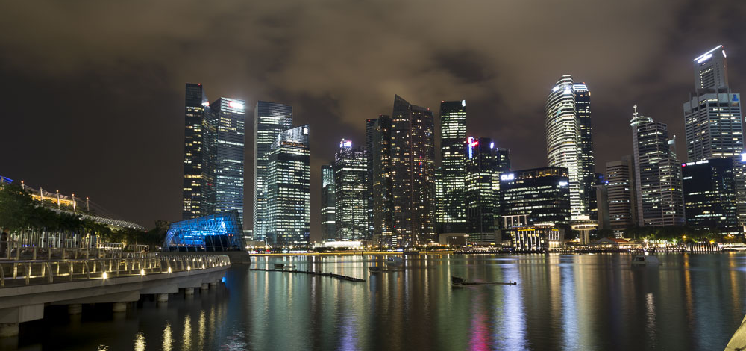
PowerShell Conference Asia

Slide 5
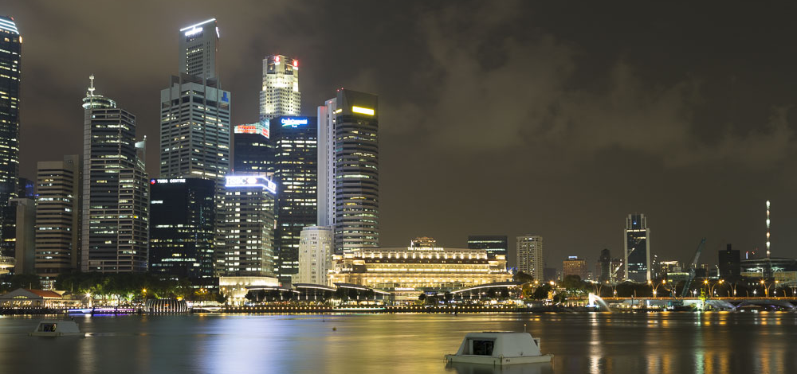
PowerShell Conference Asia

Slide 6
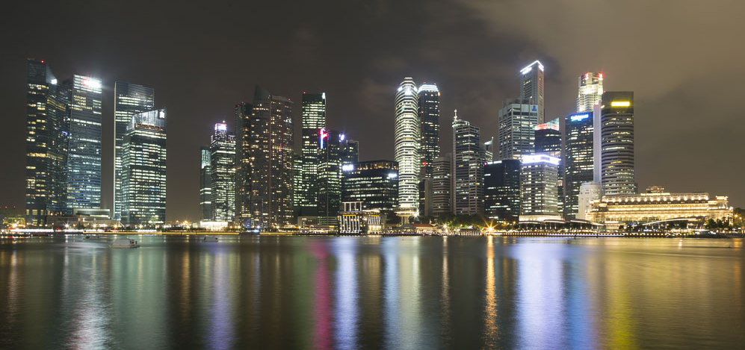
PowerShell Conference Asia

Slide 7
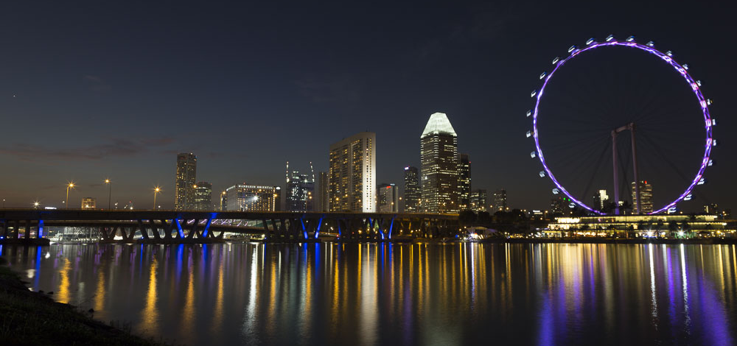
PowerShell Conference Asia

Slide 8
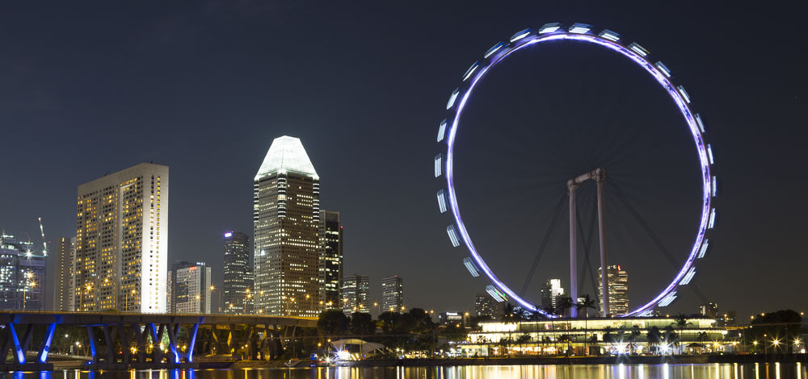
PowerShell Conference Asia

Slide 9
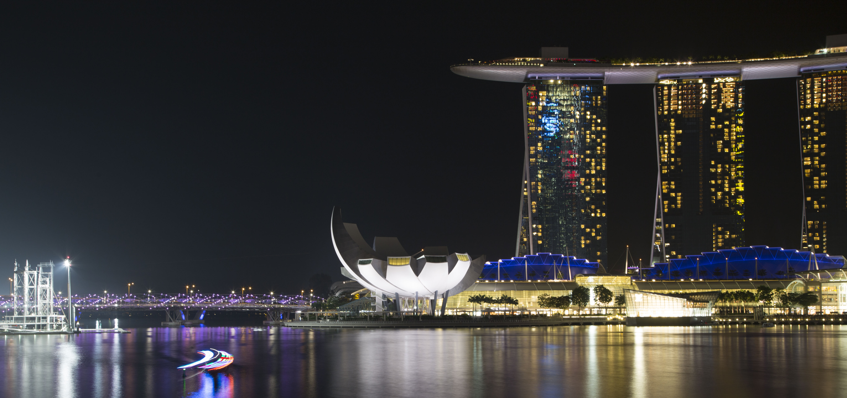
PowerShell Conference Asia

Slide 10
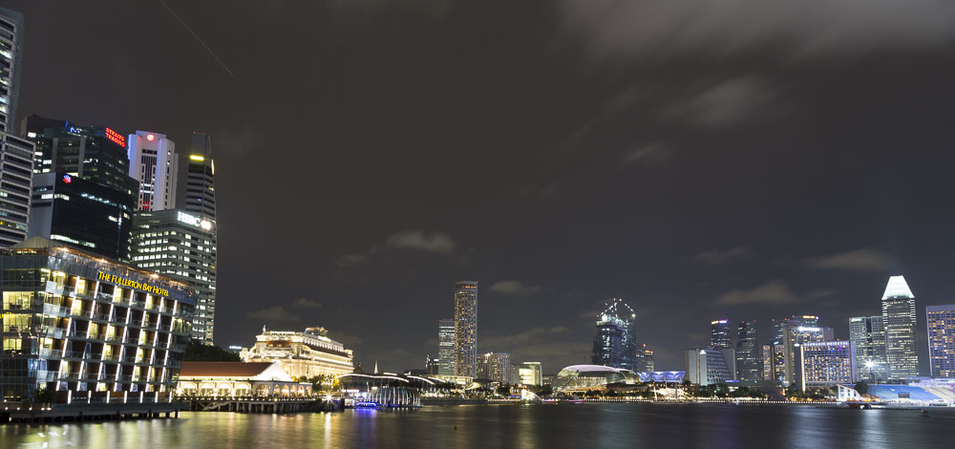
PowerShell Conference Asia

Slide 11
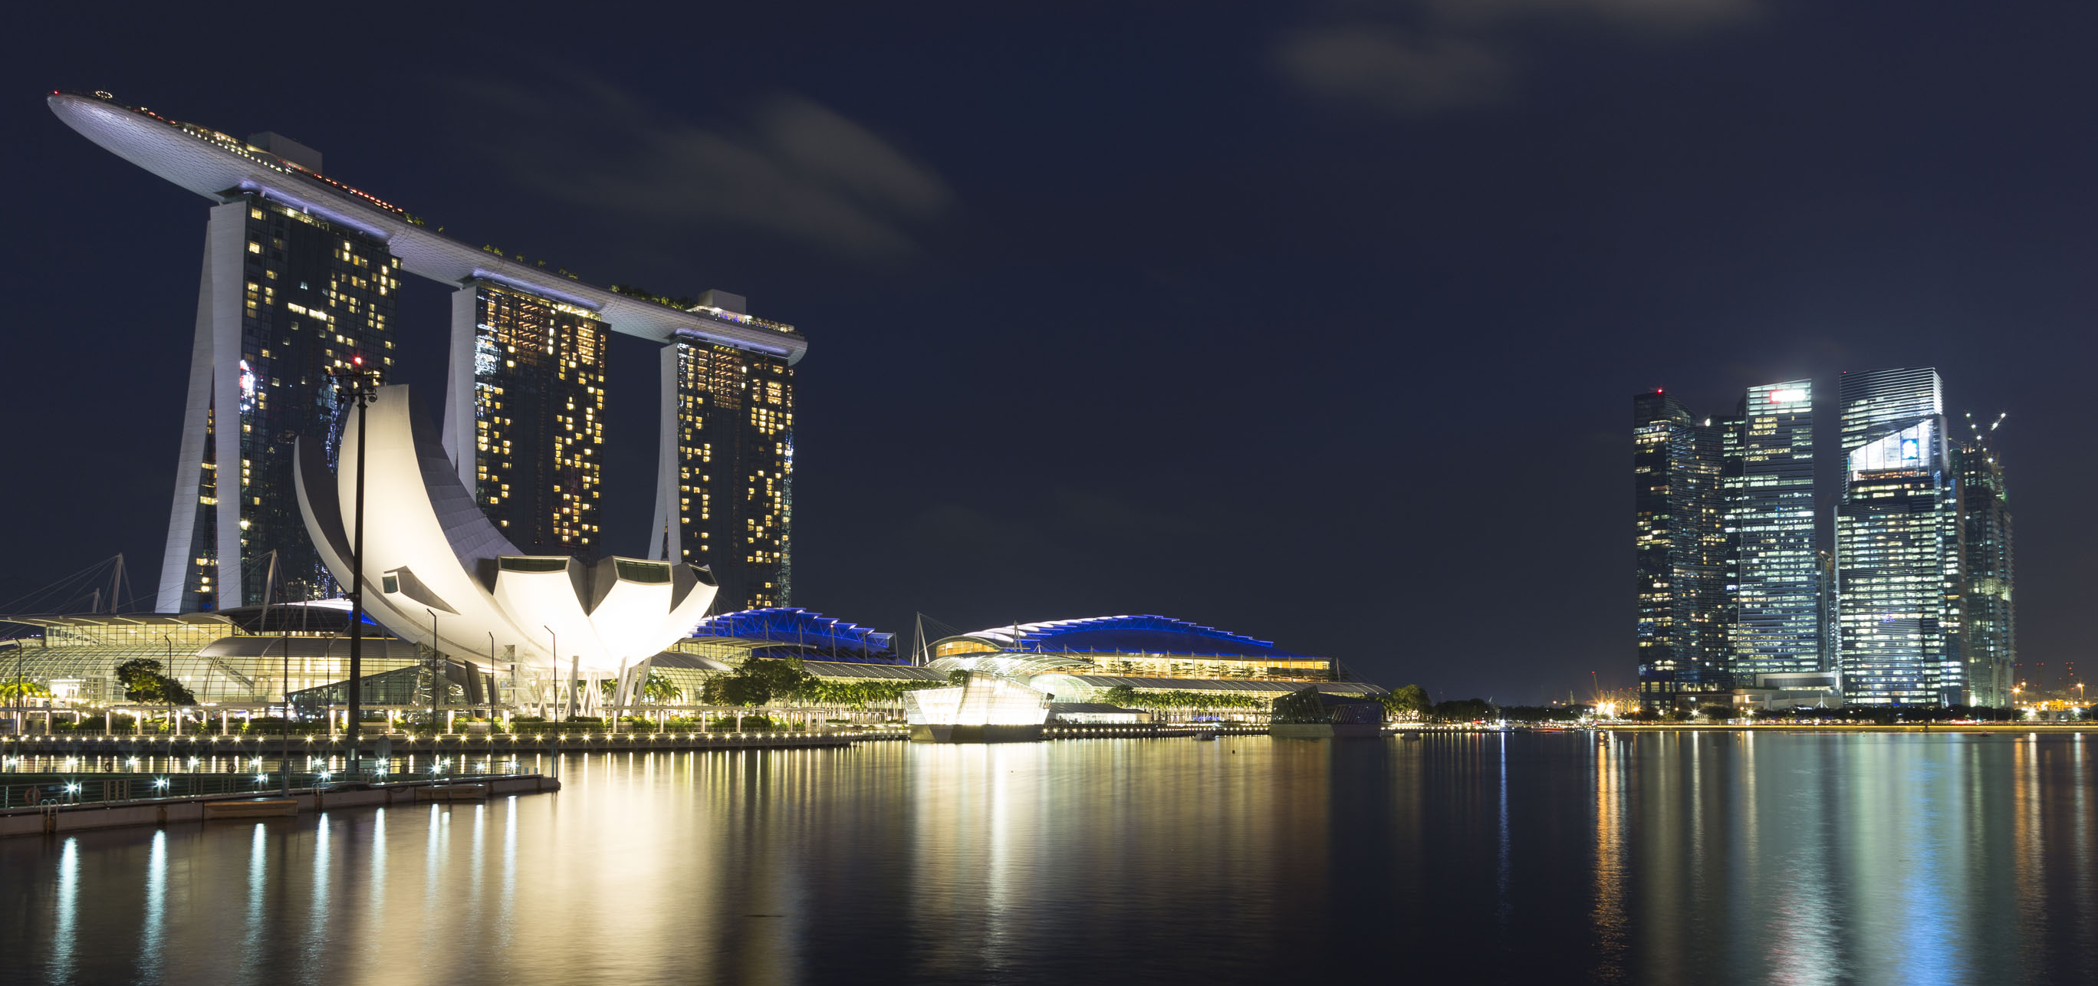
PowerShell Conference Asia

Slide 12
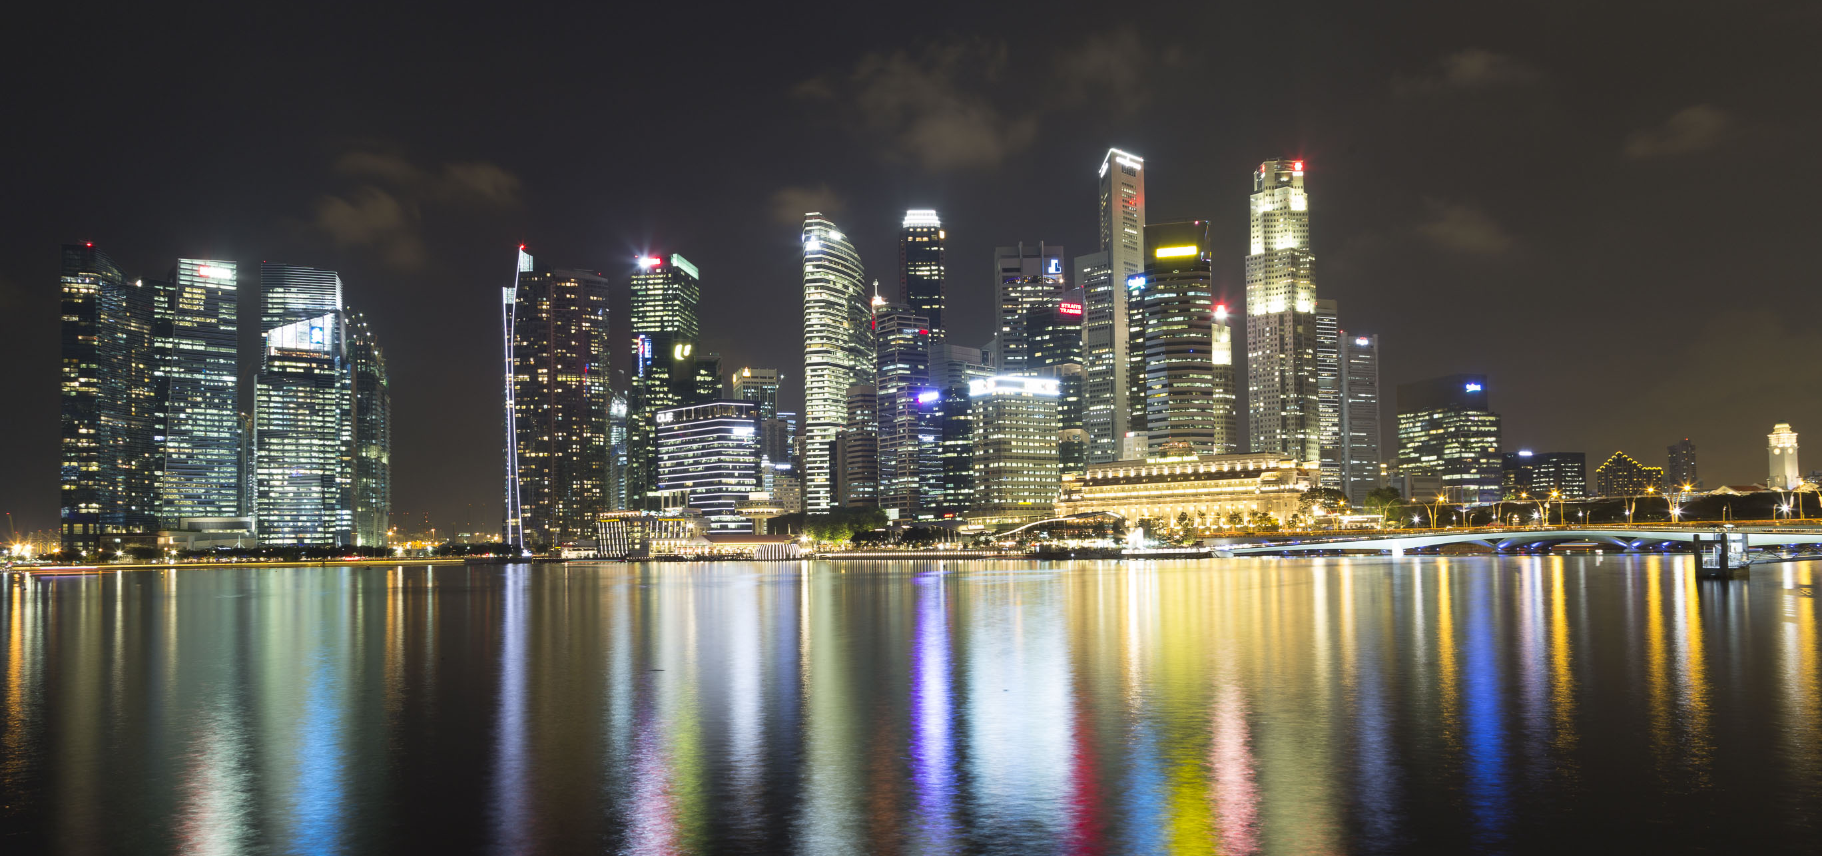
PowerShell Conference Asia

Slide 13
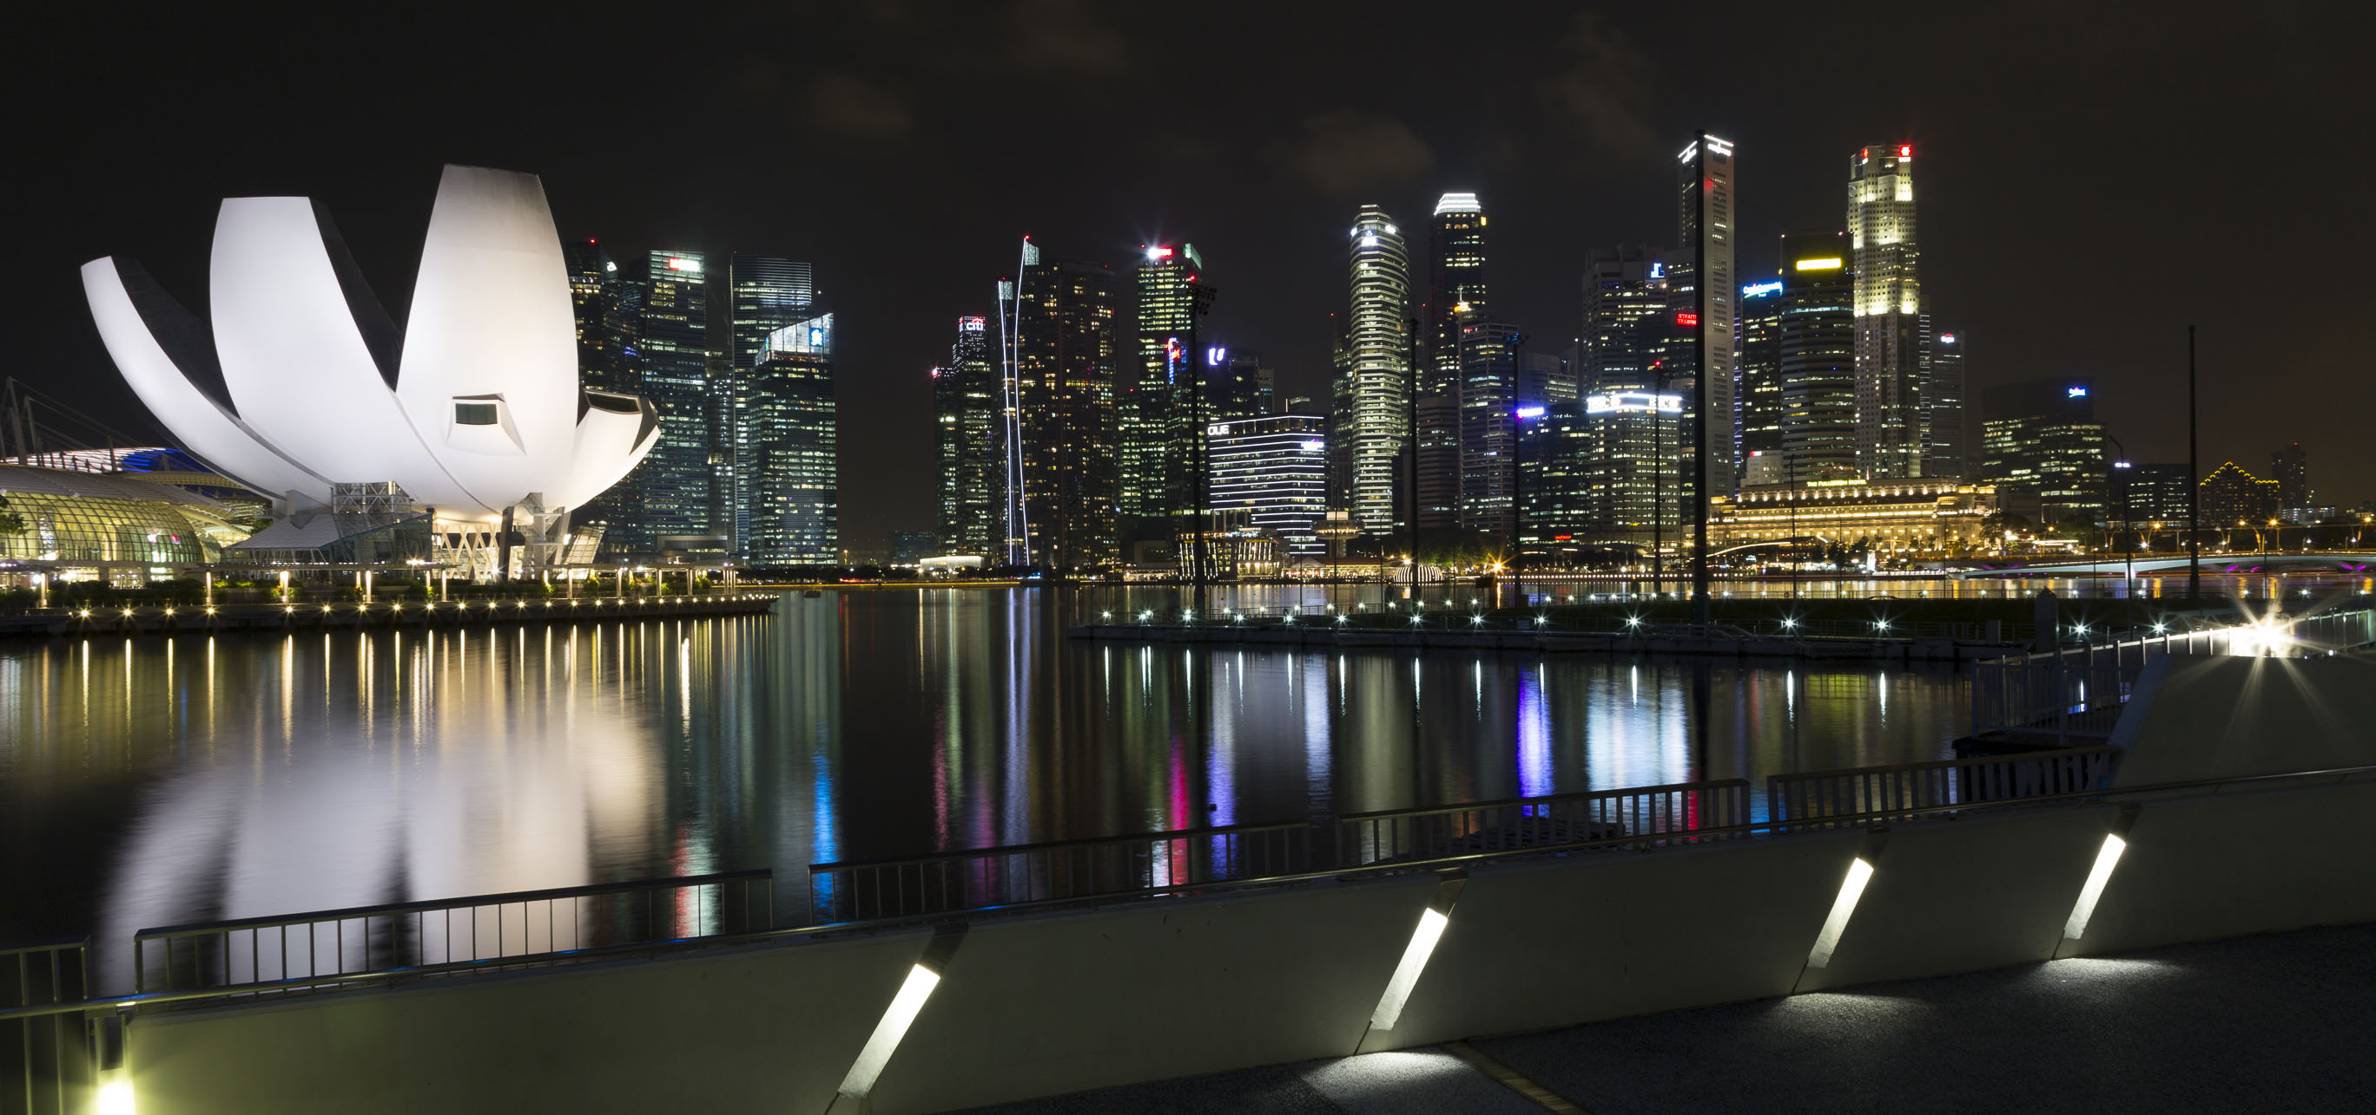
PowerShell Conference Asia

Slide 14

PowerShell Conference
Singapore 2018

Slide 15
PowerShell Conference
Singapore 2018

Slide 16
PowerShell Conference
Singapore 2018

Slide 17
PowerShell Conference
Singapore 2018

Slide 18
Don’t Forget!
Fill in your survey – it’s how we do better!
Don’t lose you badge! You need it for the Social Events
Grab the Speakers for a chat – they all have time for you!
Let everyone know what they are missing on Social Media
#PowerShell
#PSConfAsia
@Psconf.Asia
Photos of Marina Bay Credit: Sebastian Szumigalski
PowerShell Conference
Singapore 2018

